Slide 1
Lecture 2 CUDA C Programming
Kyu Ho Park
March 2, 2017

Slide 2
Computer Architecture
Single Instruction Multiple Data (SIMD) | Multiple Instruction Multiple Data (MIMD)
Single Instruction Single Data (SISD) | Multiple Instruction Single Data (MISD)
NVIDIA GPU: SIMT(Single Instruction Multiple Thread)

Slide 3
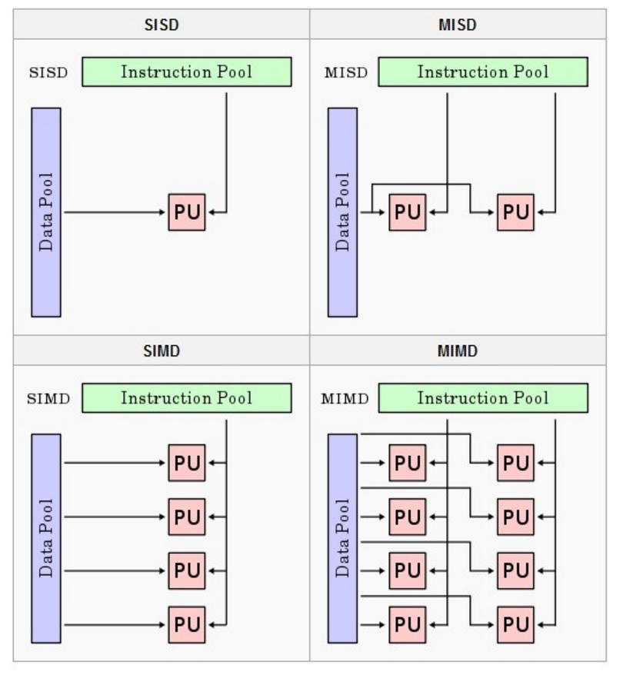
Flynn’s Taxonomy

Slide 4
Classification based on the memory organization
Multi-node with distributed memory
(Shared nothing architecture)
Multiprocessor with shared memory
(Shared everything architecture)

Slide 5
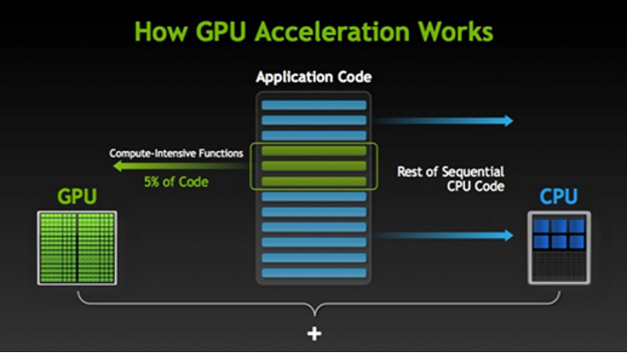
Heterogeneous Computing [NVIDIA]

Slide 6
NVIDIA’s GPU
Tegra | For mobile and embedded devices such as tablets and phones.
GeForce | For consumer graphics.
Quadro | For professionl visualization.
Tesla | For data center parallel computing. Fermi: GPU accelerator in the Tesla product family. Kepler: the current generation of GPU computing architecture after Fermi.

Slide 7
Fermi and Kepler
 | FERMI (Tesla c2050) | KEPLER (Tesla k10)
CUDA cores | 448 | 1536 x 2
Memory | 6GBytes | 8GBytes
Peak Performance | 1.0 TFLOPS | 4.6 TFLOPS
Memory Bandwidth | 144GBytes/s | 320 Gbytes/s

Slide 8
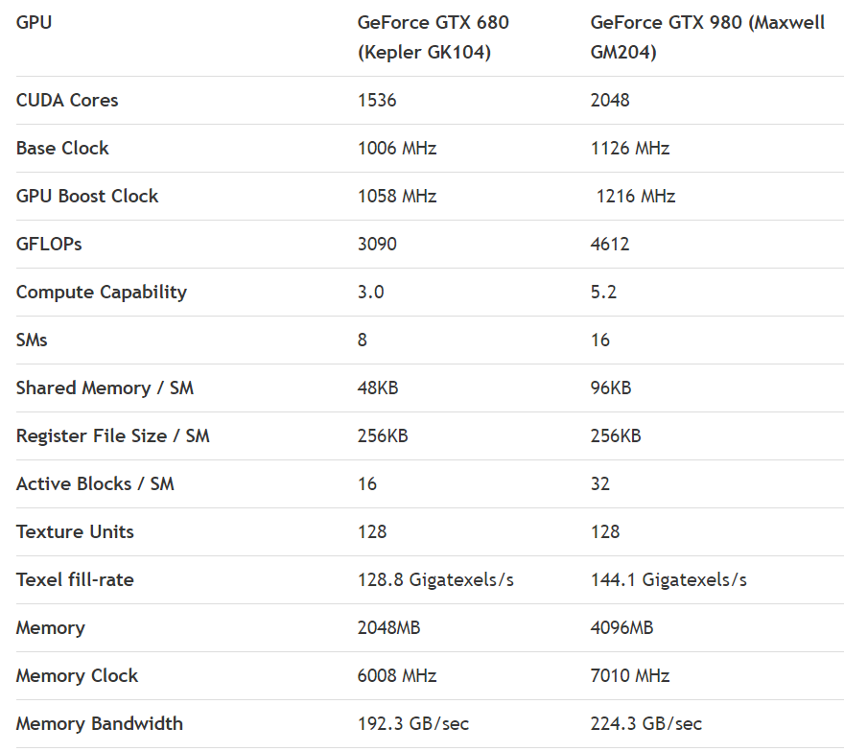
Kepler and Maxwell

Slide 9
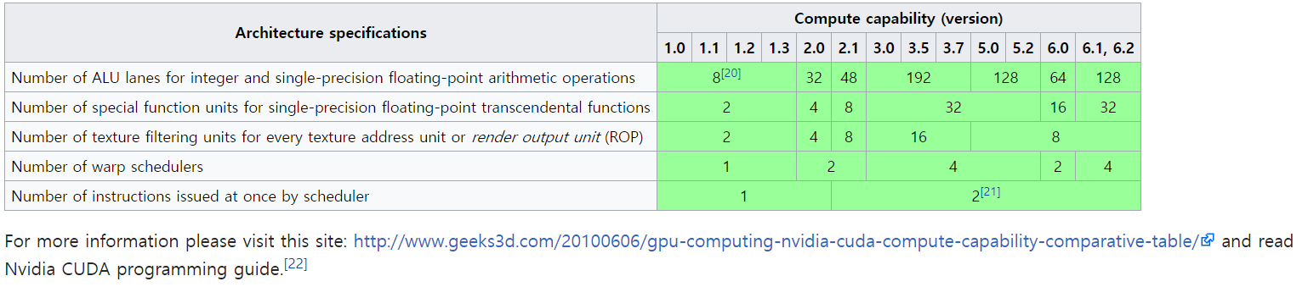
Compute Capability
CC 1: Tesla, 2: Fermi, 3: Kepler, 5: Maxwell, 6: Pascal, 7: Volta

Slide 10
CUDA Architecture
2006: Advent of NVIDIA’s GeForce 8800GTX
the first GPU of CUDA Architecture
for general purpose computing, ALUs complying IEEE requirements, allowing R/W of shared memory
Few months after the launch of GeForce 8800GTX, CUDA C announced.
the first language for general-purpose computing on GPU.

Slide 11
Hello,World!
#include <stdio.h>
int main(void){
printf(“Hello, World!\n”);
return 0;
}

Slide 12
Making CUDA C Program
Create a source code file with the special file name extension of .cu .
Compile the program using the CUDA nvcc compiler.
Run the executable file.

Slide 13
Kernel Program
#include <stdio.h>
__global__ void funct(void) {
printf(“Hello from GPU!\n”);
}
int main(void){
funct<<<1,4>>>( );
printf(“Hello, World from CPU!\n”);
cudaDeviceReset();
return 0;
}
Angle bracket

Slide 14
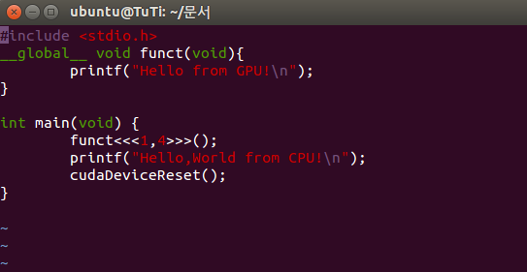
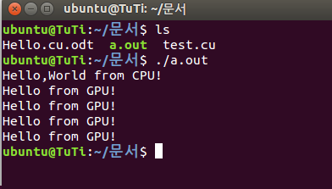
$nvcc test.cu and $ ./a.out

Slide 15
Terminology
Host: CPU and the system’s memory
Device: GPU and its memory
Kernel: A function that executes on the device.

Slide 16
__global__ function qualifier
CUDA C adds the __global__ qualifier to standard C. It alerts the compiler that a
function is to be compiled to run on a device.
‘nvcc’ sends the funct( ) to the compiler that handles device code. And it feeds main( ) to the host compiler.
CUDA nvcc compiler separates the device code from the host during the compilation process.

Slide 17
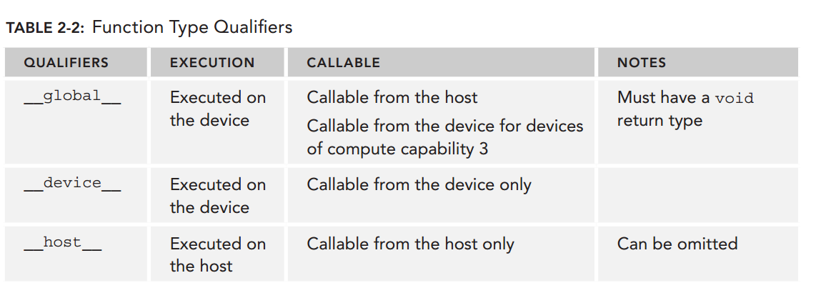

Slide 18
CUDA NVCC
CUDA Libraries | Integrated CPU and GPU code
CUDA Assembly for Computing | CPU Host Code
CUDA Driver / Debugger | C Compiler
GPU | CPU
CUDA Compiler

Slide 19
CUDA C Extension
function type qualifiers
__global__, __device__, __host__,
__device__ __host__
__global__ void function1 <<< 6,4>>>( )
{ …}
function1 is only executed at a device. It can be called from the host but cannot be called recursively at the device.

Slide 20
__global__ void function1
#include <stdio .h>
__global__ void add(int a, int b, int *c) {
*c = a + b;
}
int main() {
int c;
int *dev_c;
cudaMalloc((void**)&dev_c, sizeof(int));
add<<<1, 1>>>(2, 7, dev_c);
cudaMemcpy(&c, dev_c, sizeof(int), cudaMemcpyDeviceToHost);
printf("2 + 7 = %d\n", c);
cudaFree(dev_c);
return 0;
}

Slide 21
__global__ void function<< 6,4>>
return value is always void,
recursive call is not allowed,
function cannot have static variables,
can not declare __host__ at the same time,
declared 6 blocks and 4 threads per block.

Slide 22
__device__ int function( )
The function is executed at a device,
It can be called by the device and cannot be called by the host,
It can not be called recursively,
It can not have variable number of arguments,

Slide 23
__host__ int function (int a, int b)
It is executed only at a host,
It can not be called by the device,
If __global__, __host__, __device__ are not declared, it is considered as __host__,
It cat not be used with __global__ ,
It can be declared with __device__ , in this case the function can be executed at the host and the device.

Slide 24
variable type qualifiers
__device__
the variable is allocated to the global memory,
effective until the end of program execution,
all threads can access the variable,
the host can access it through API function.

Slide 25
__constant__
2. __constant__
the variable is allocated to the constant memory area,
all can read only the variable,
the host can write the value through cudaMemcpyToSymbol( ) API.

Slide 26
__shared__
3. __shared__
the variable is allocated to the shared memory area of a block,
all threads in a block can read and write the variable.
Question:
Global Memory, Constant Memory,
Shared Memory?

Slide 27
Memory Management
C Functions | CUDA C Functions
malloc | cudaMalloc
memcpy | cudaMemcpy
memset | cudaMemset
free | cudaFree

Slide 28
Allocation, Deallocation and Copying of Graphic Card Memory(GCM)
1. Memory Allocation of GCM
cudaError_t cudaMalloc(void** devPtr, size_t count);
2. Freeing GCM
cudaError_t cudaFree(void* devPtr);
3. Copying GCM
cudaError_t cudaMemcpy(void* dst, const void* src, size_t count, cudaMemcpyHostToDevice);

Slide 29
Every CUDA call returns cudaSuccess or
cudaErrorMemoryAllocation

Slide 30
cudaMemcpy( )
Last parameter of cudaMemcpy( )
Parameter | Action
cudaMemcpyHostToHost | Copy from MM to MM
cudaMemcpyHostToDevice | Copy from MM to GCM
cudaMemcpyDeviceToHost | Copy from GCM to MM
cudaMemcpyDeviceToDevice | Copy from GCM to GCM

Slide 31
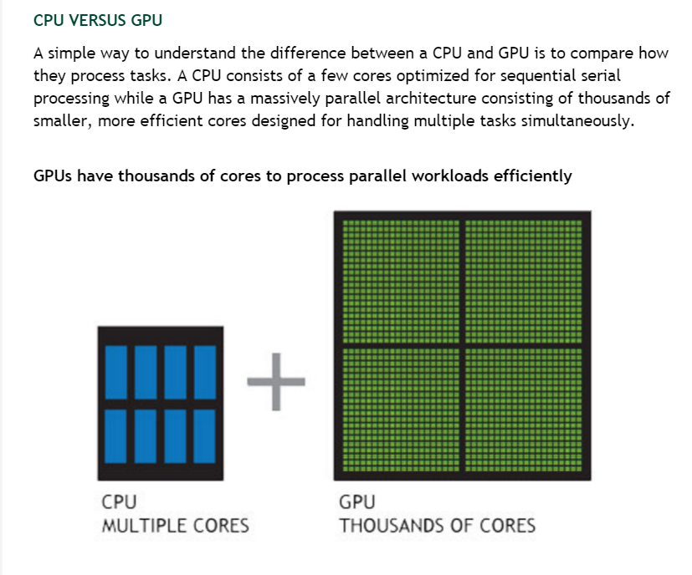
GPU Parallel Processing

Slide 32
Processing Procedure
Allocation of I/O Main Memory
Allocation of I/O GCM
Input data to Main Memory
Copy input data from MM to GCM
Distribute the data to the memory of GPU
Process by executing threads in parallel
Load the process data to the output GCM
Send the output data of GCM to MM
Free GCM
Free MM

Slide 33
Host and Device
Host: The CPU and the System’s Memory
Device: the GPU and its memory

Slide 34
Kernel Function of CUDA
A function that executes on the device is called a kernel.
_ _ global_ _ void KernelFunction(int a , int b, int c)
{
….
}
/*
Qualifier _ _ global_ _ : It alerts the compiler that a function should be compiled to run on a device instead of the host.
No return value: void
*/

Slide 35
Calling a KernelFunction
#include <stdio.h>
__global__ void kernel(int a, int b){
int sum=a+b;
}
int main()
{
kernel<<<6, 1>>>(10,21);
printf(…);
}

Slide 36
Kernel<<<6,1>>>(10,21)
<<<6,1>>> ; the number of blocks = 6,
the number of thread(s) per block=1.

Slide 37
Thread-Block-Grid Model
thread
block
grid

Slide 38
Memory Hierarchy and Thread-Block-Grid
GRID
Block(0,0)
Shared Memory
Host
Thread(0,0)
Thread(1,0)
Thread(2,0)
Thread(3,0)
PCI bus
Global Memory
cudaMalloc
cudaMemcpy
cudaMemset
cudaFree

Slide 39
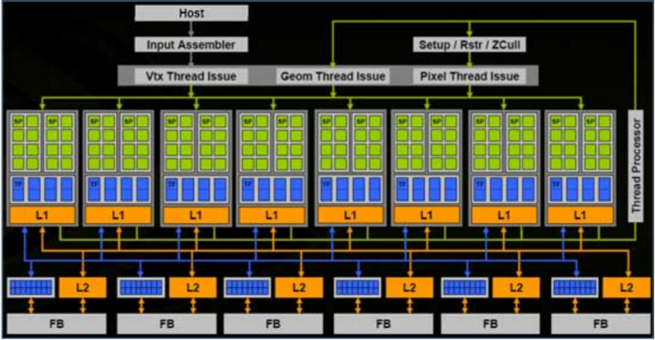
CUDA Processor Architecture

Slide 40
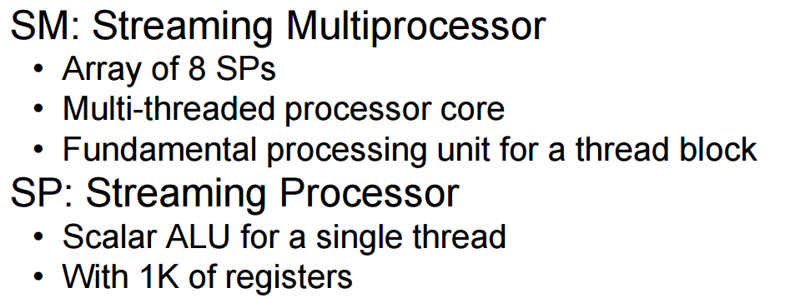
Streaming Processor(SP)

Slide 41
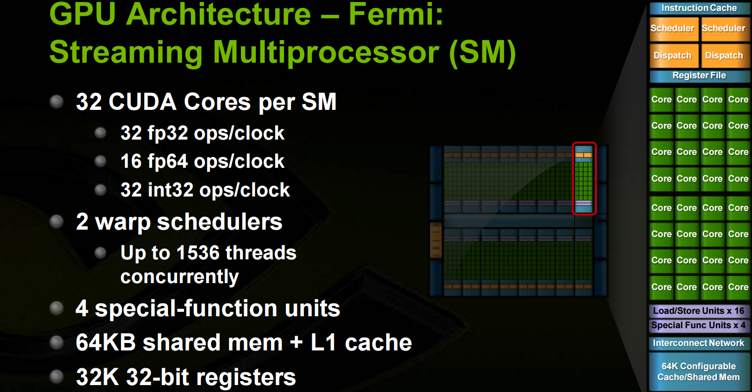
SM(Streaming Multiprocessor)

